Slide 1
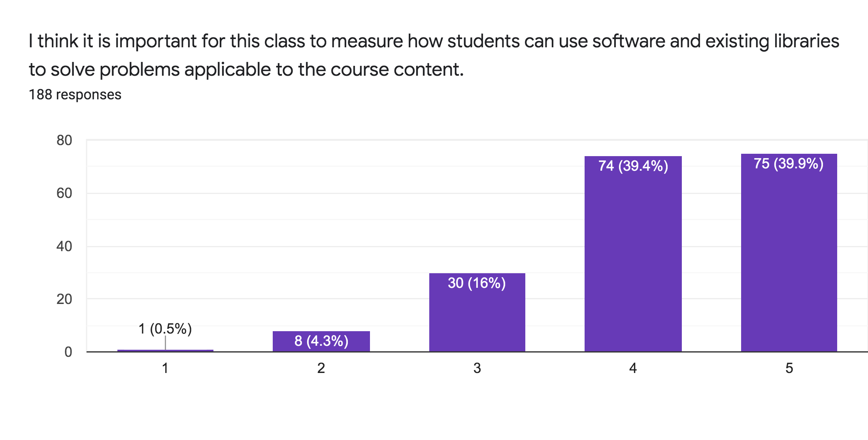

Slide 3
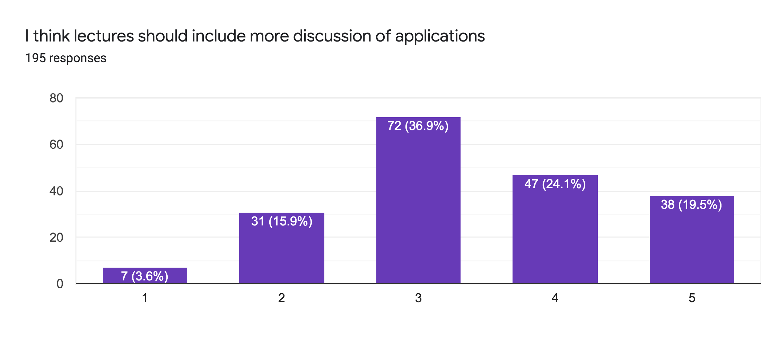

Slide 4
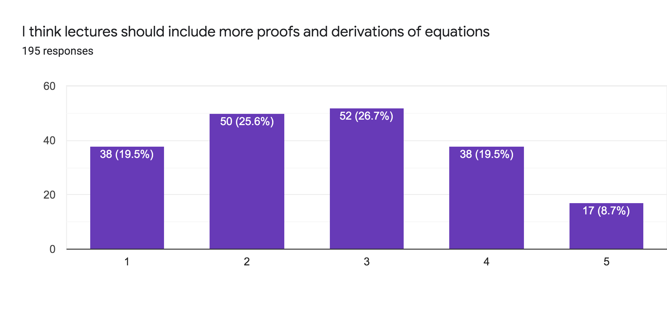

Slide 5
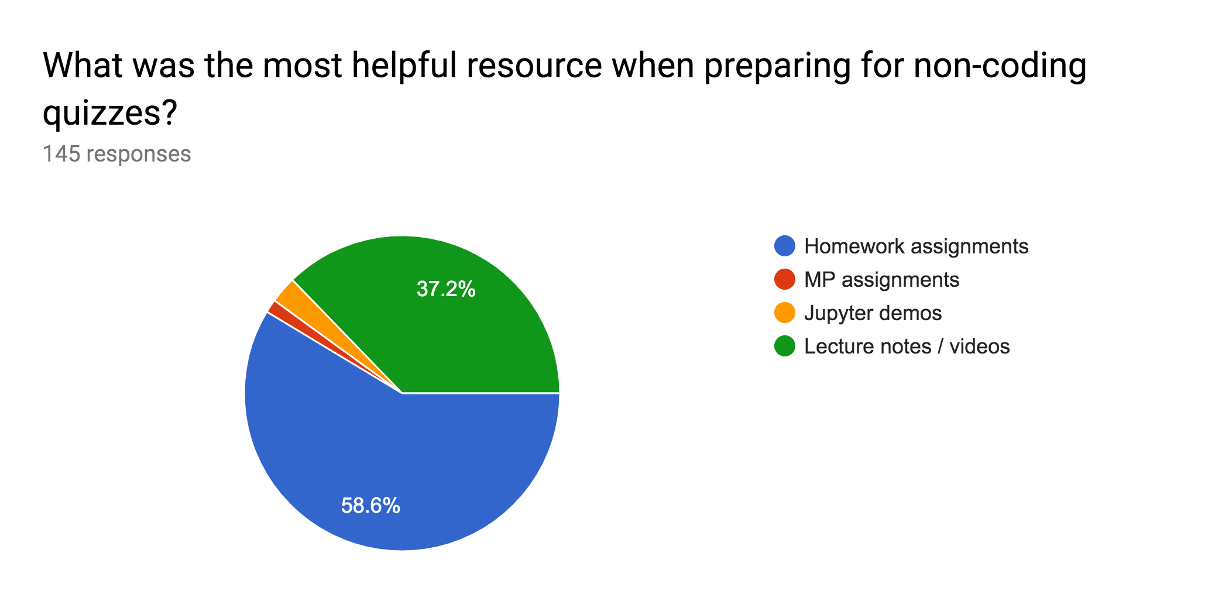

Slide 6
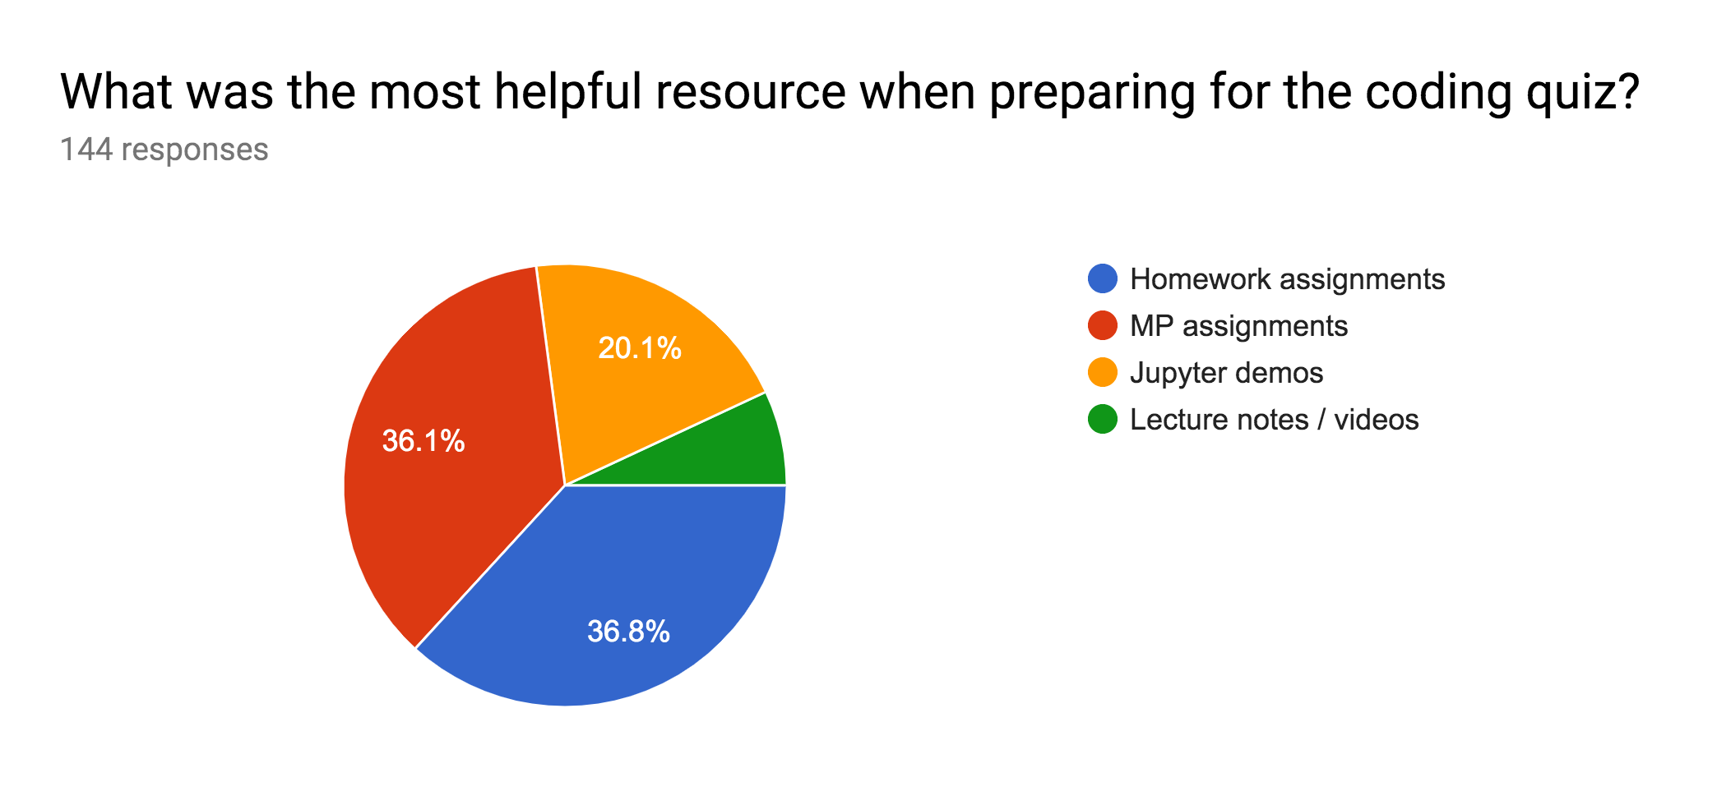

Slide 7
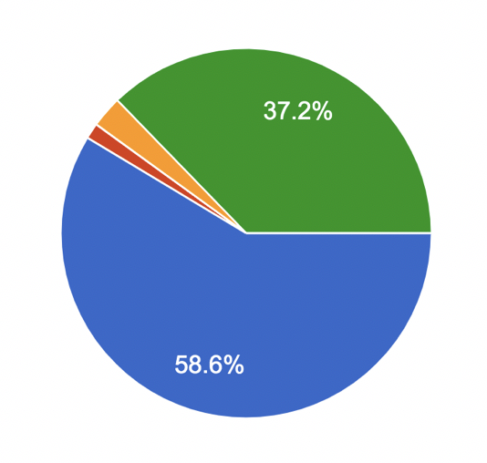
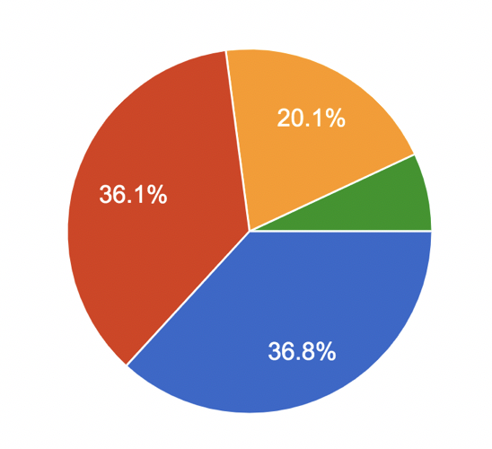
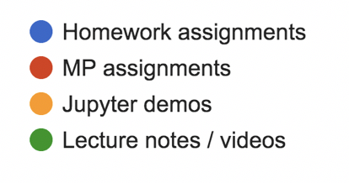
Most helpful resource when preparing for the non-coding quizzes
Most helpful resource when preparing for the coding quizzes

Slide 8
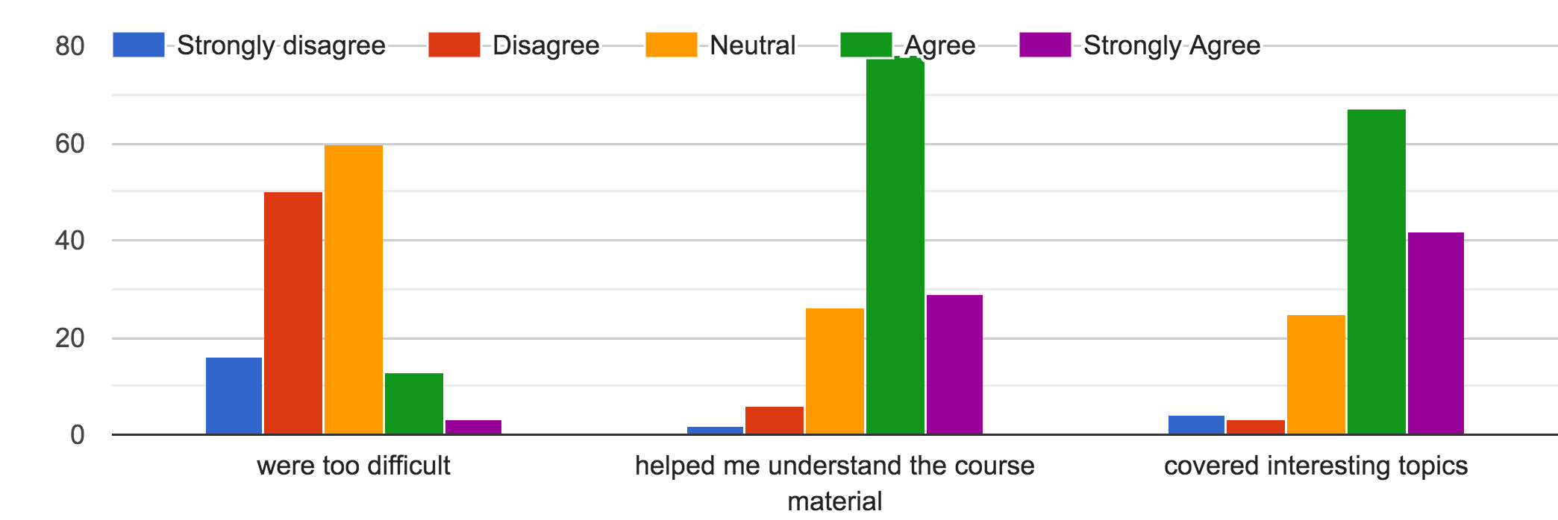

Slide 9
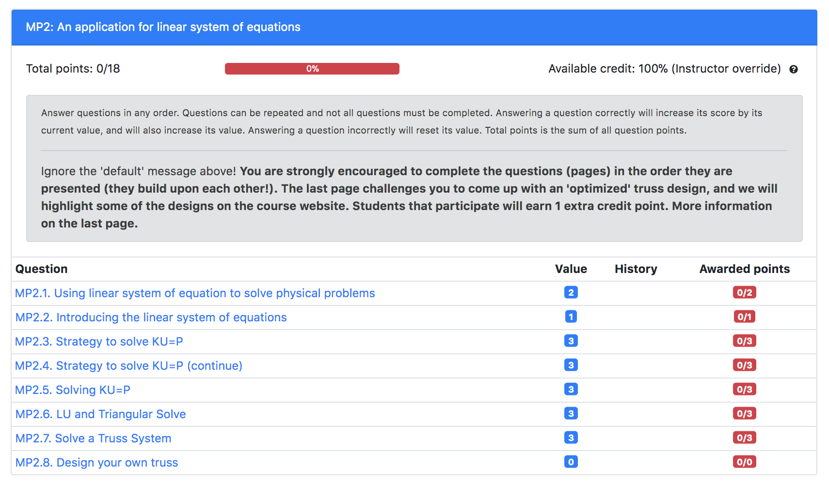
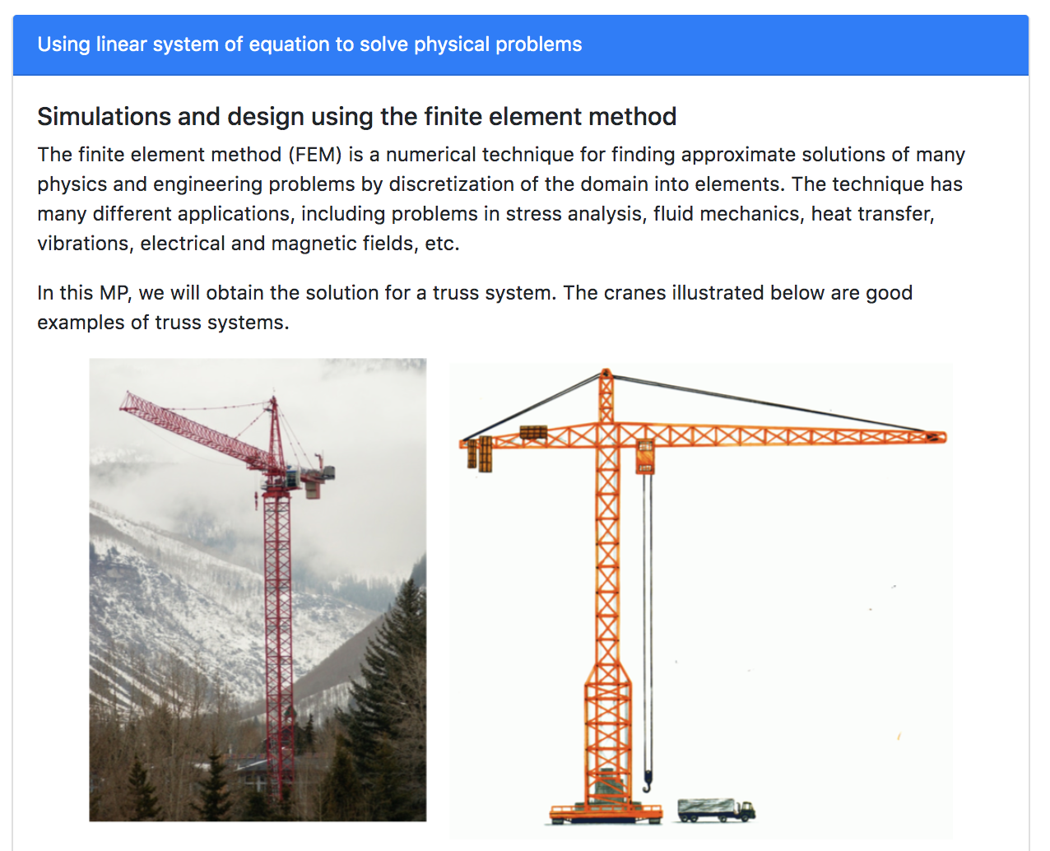

Slide 10
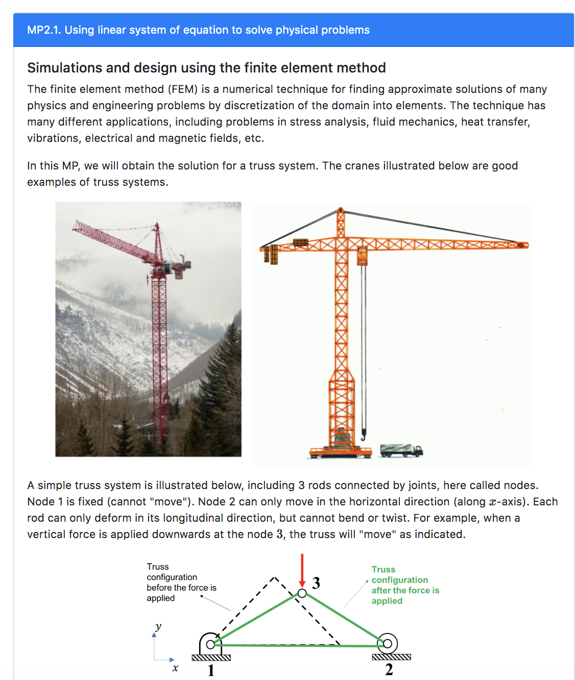
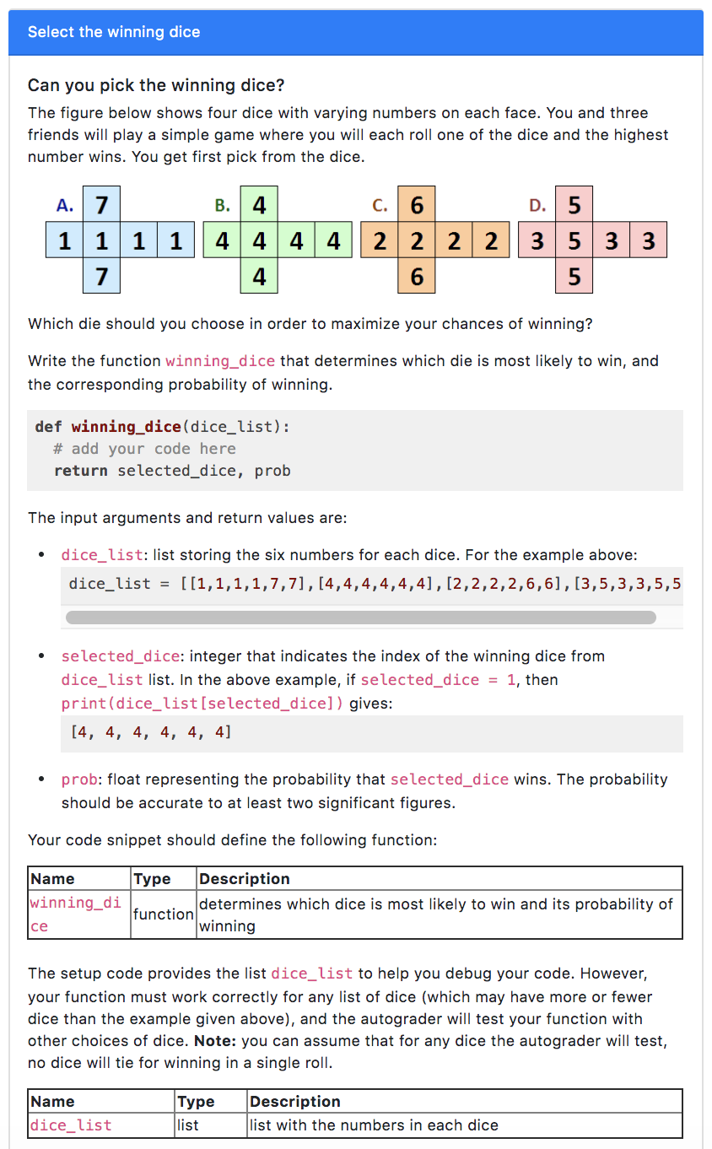

Slide 11
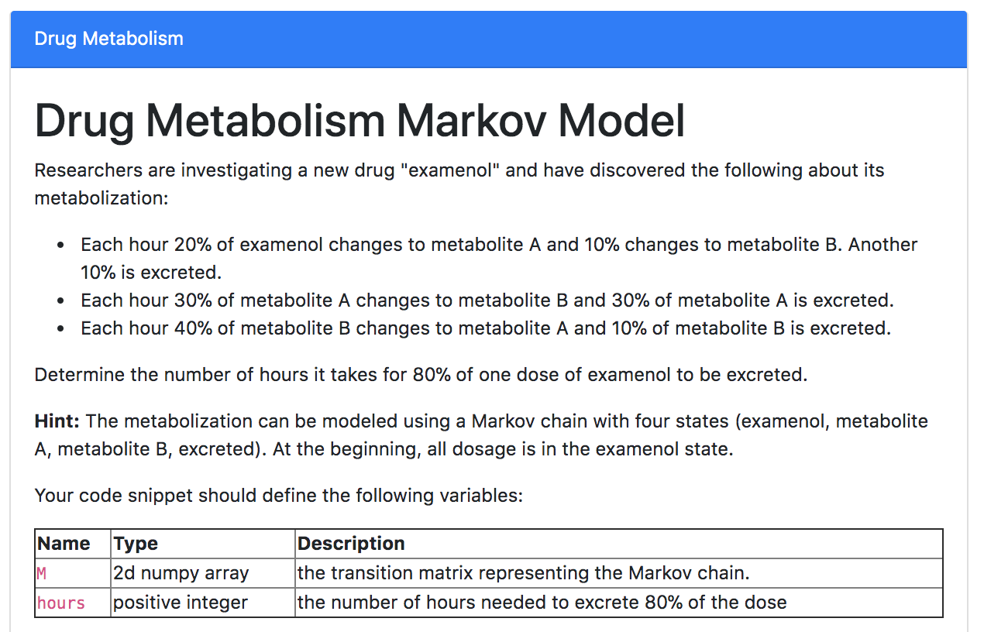

Slide 12
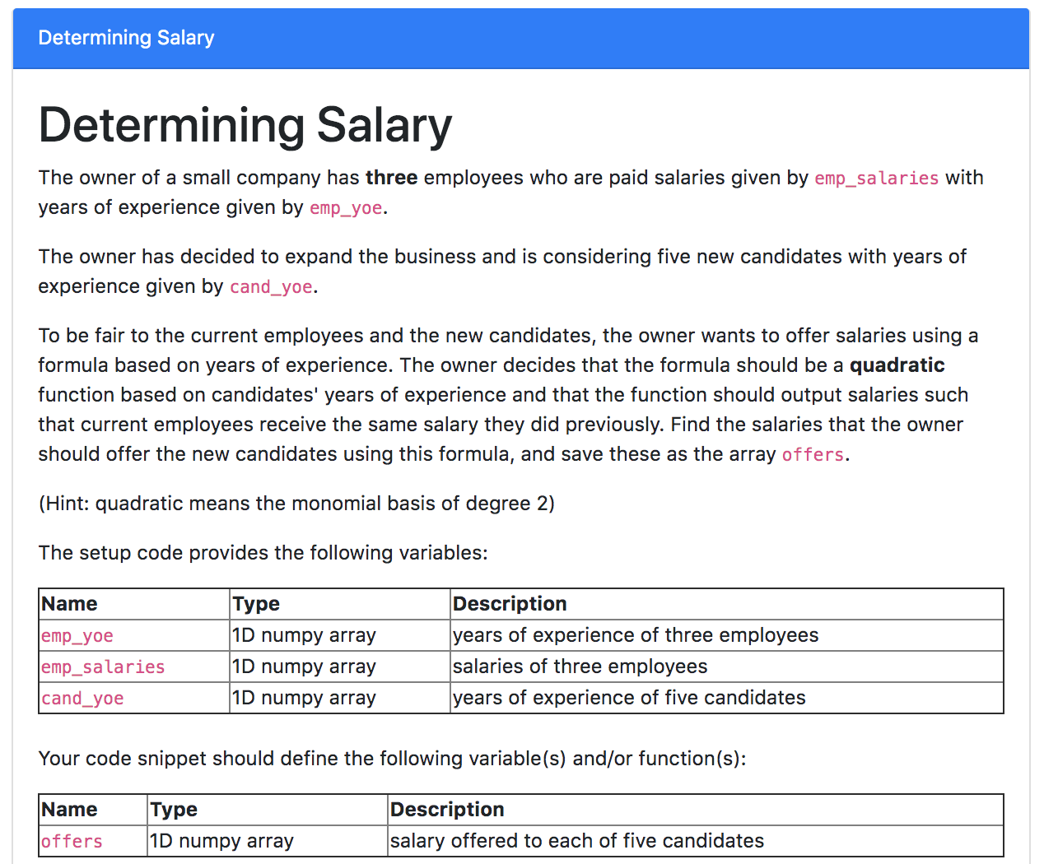

Slide 13
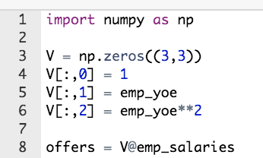
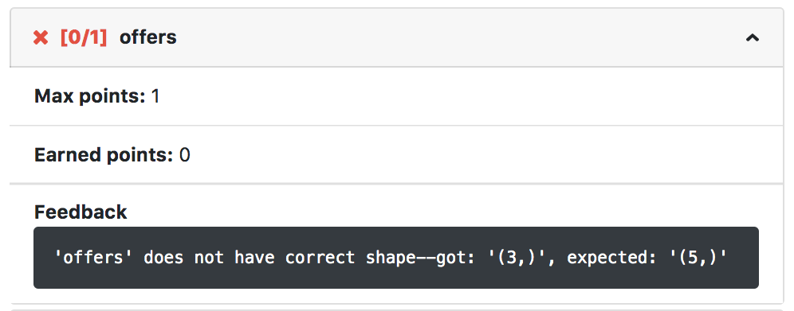
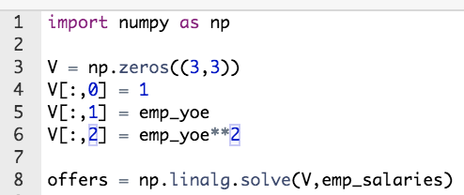
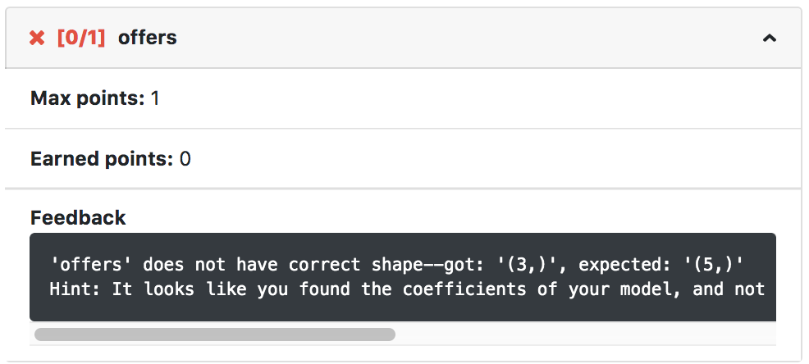
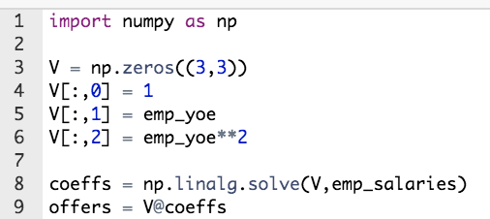
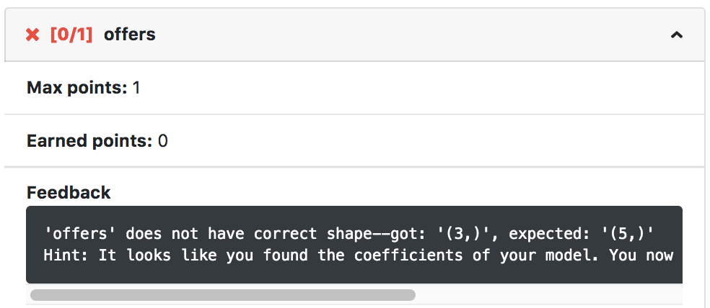
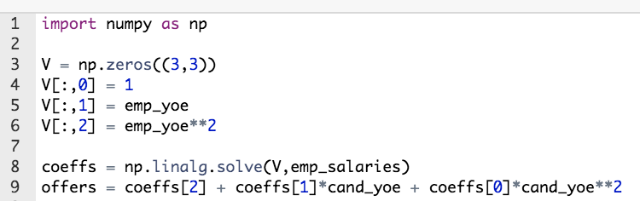
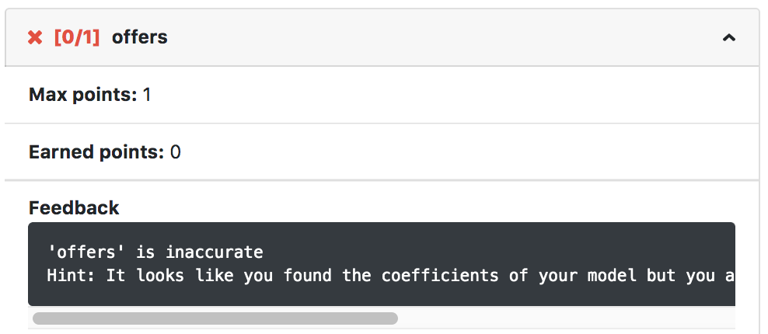

Slide 14
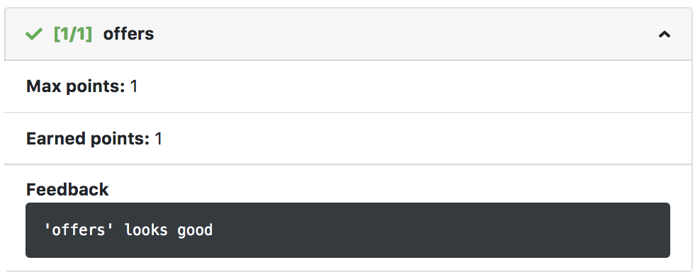

Slide 15
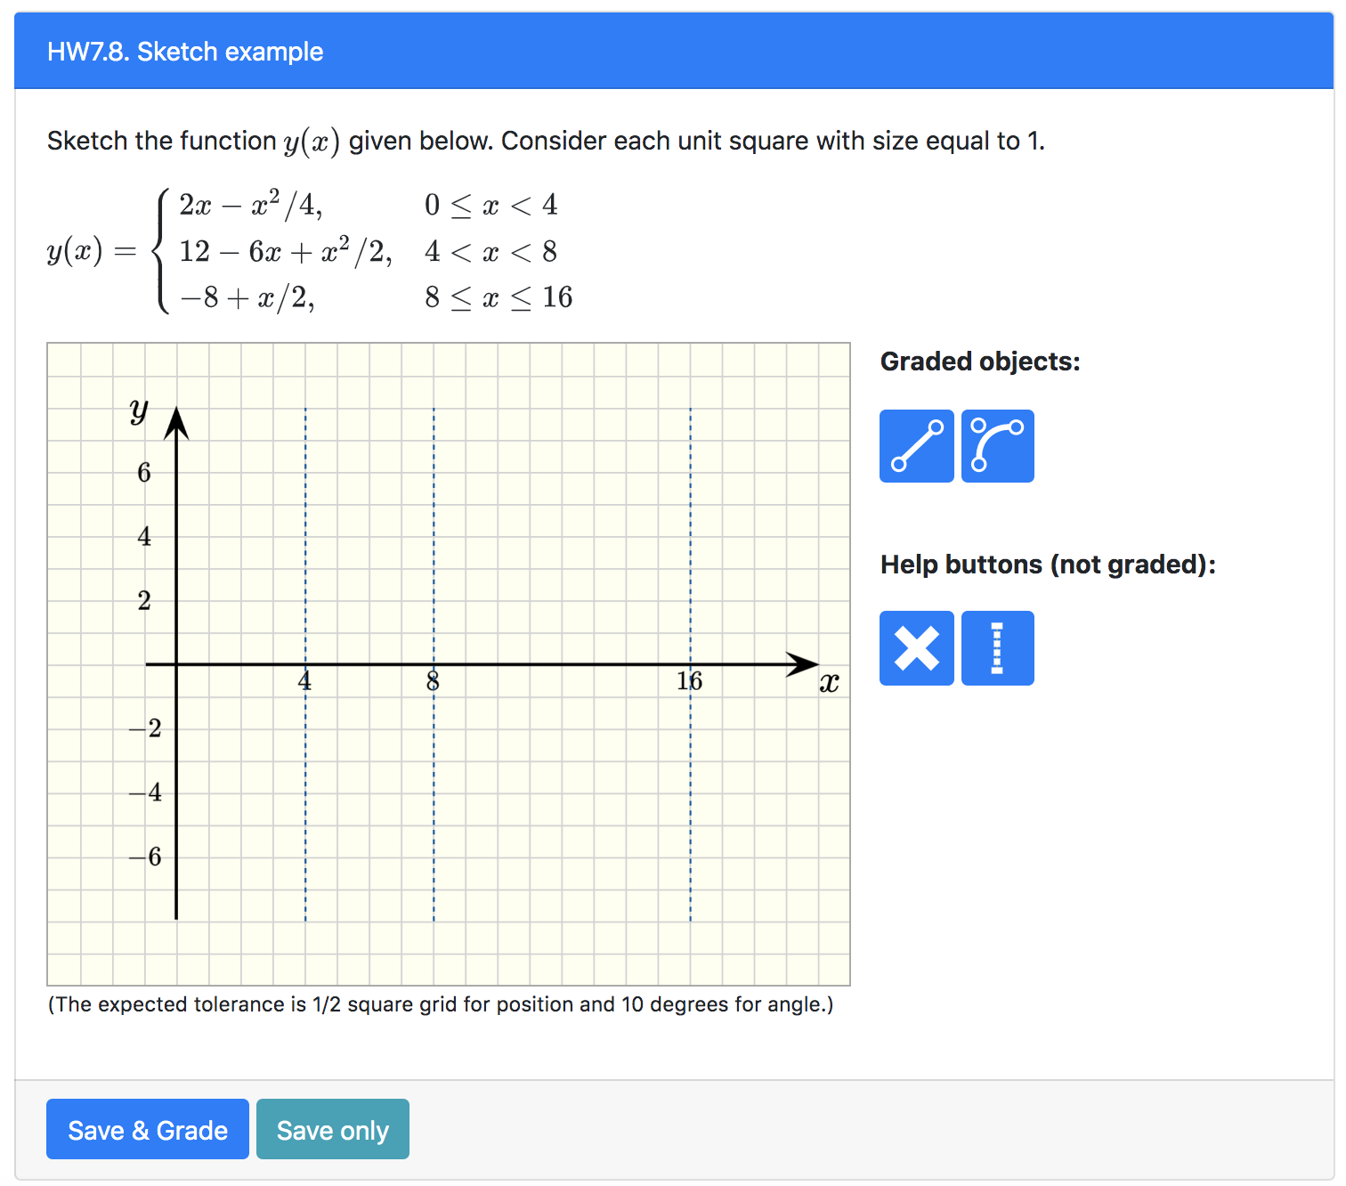

Slide 16
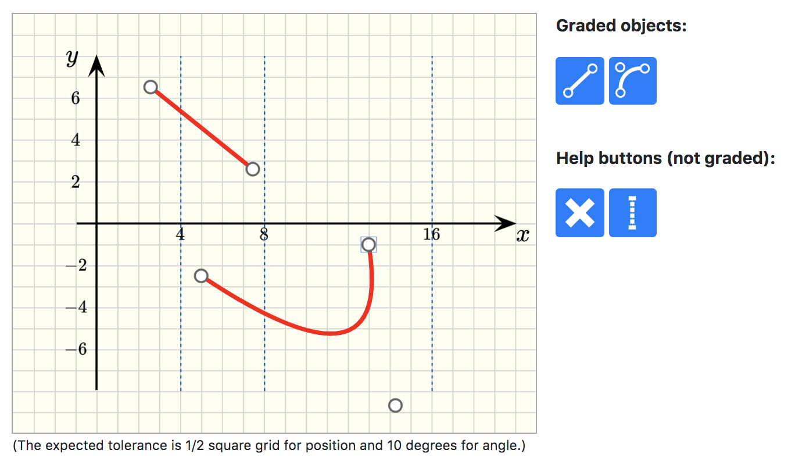
The purple boxes indicate the “control points”
Button to insert lines (1)
Button to insert quadratic curves (2)
(1)
Add the vertical lines (to help with placement of graded objects)
(2)
Delete selected objects (only the ones included by the user)

Slide 17
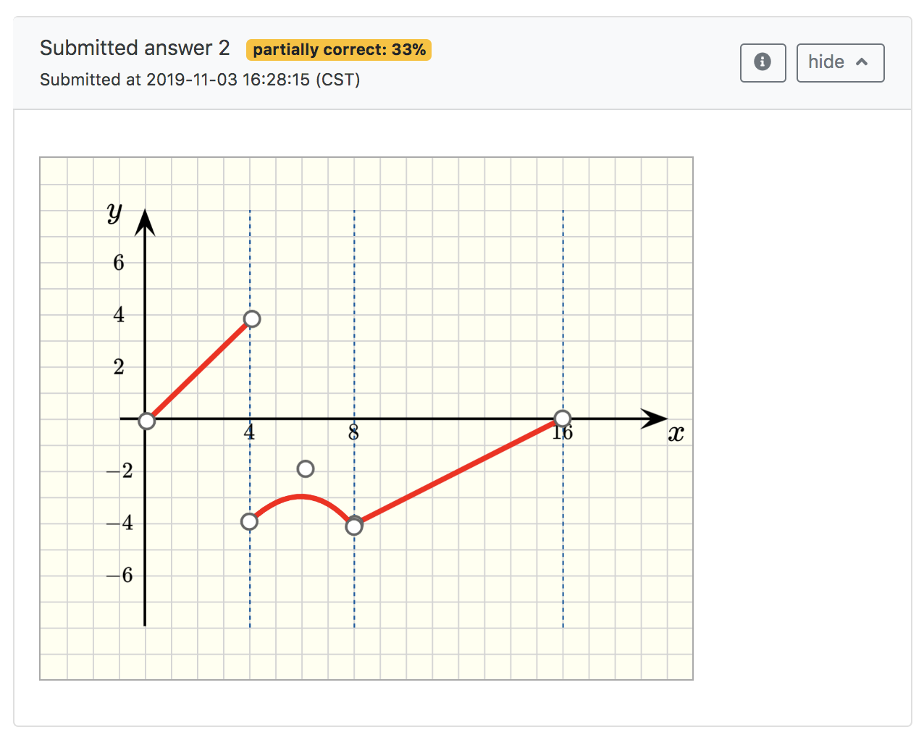
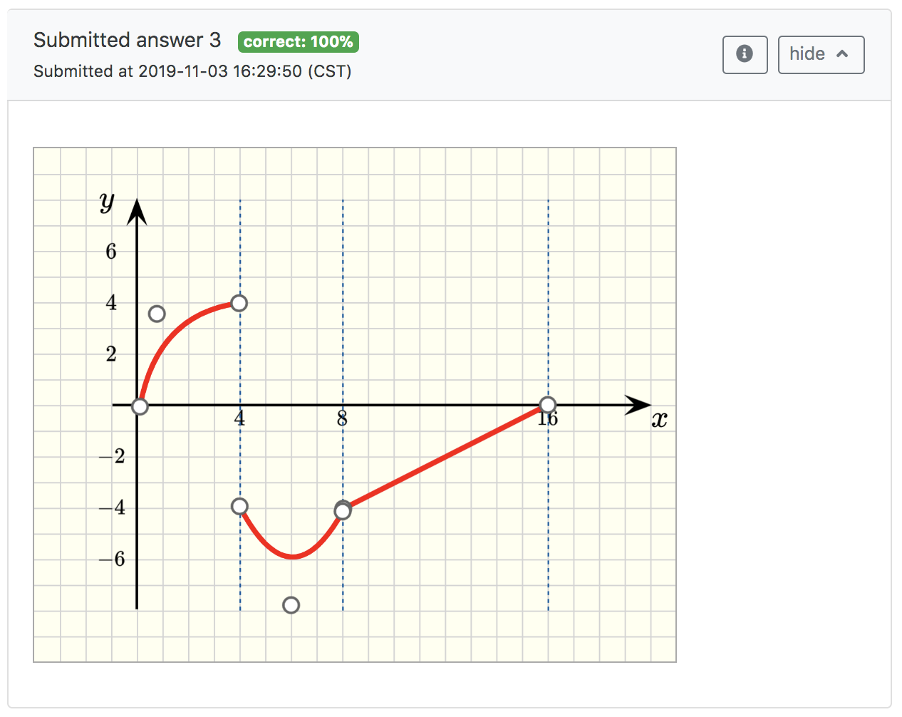

Slide 18
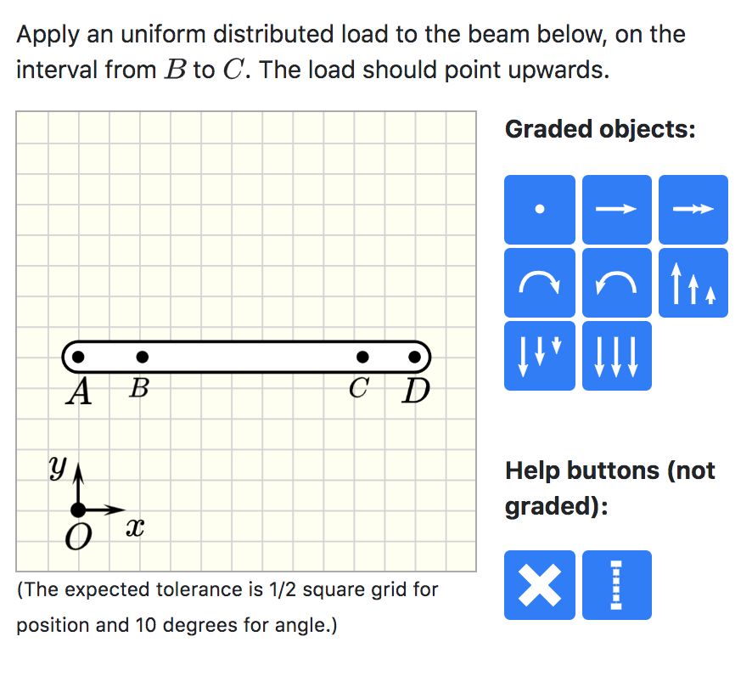

Slide 19
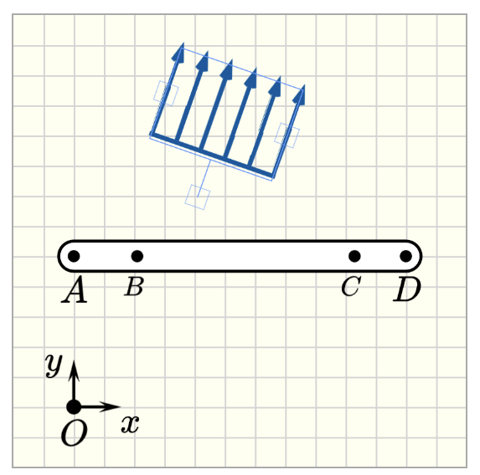
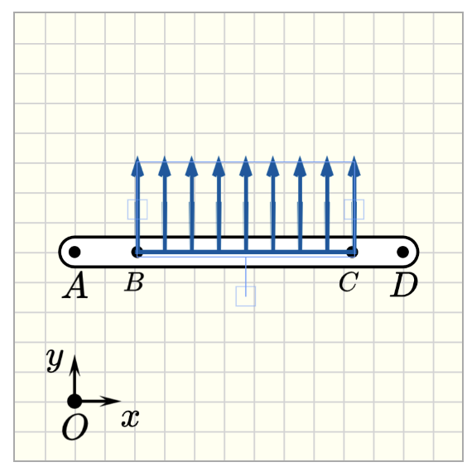
Handle to control the rotation of the object distributed load
Handle to adjust the interval size of the object distributed load
Object moved to correct location

Slide 20
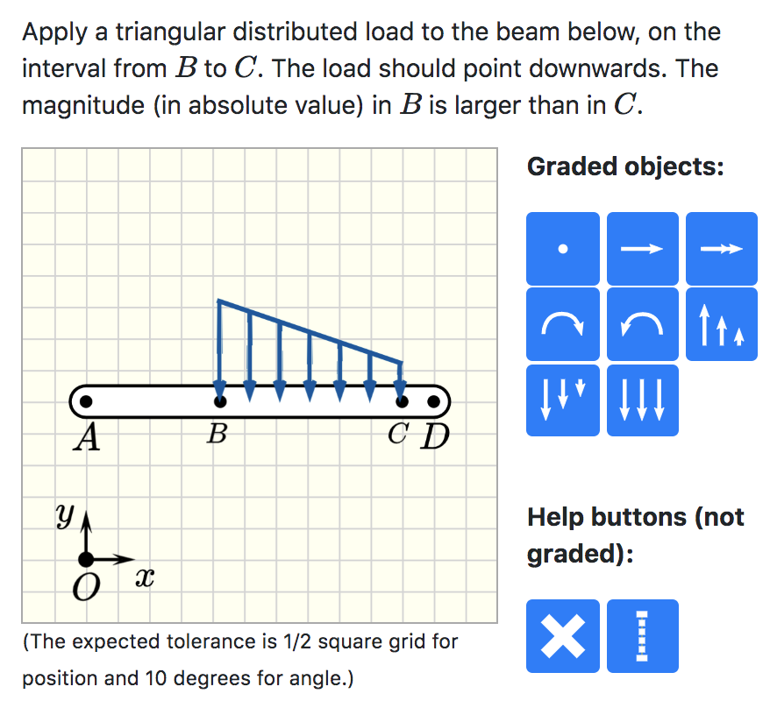
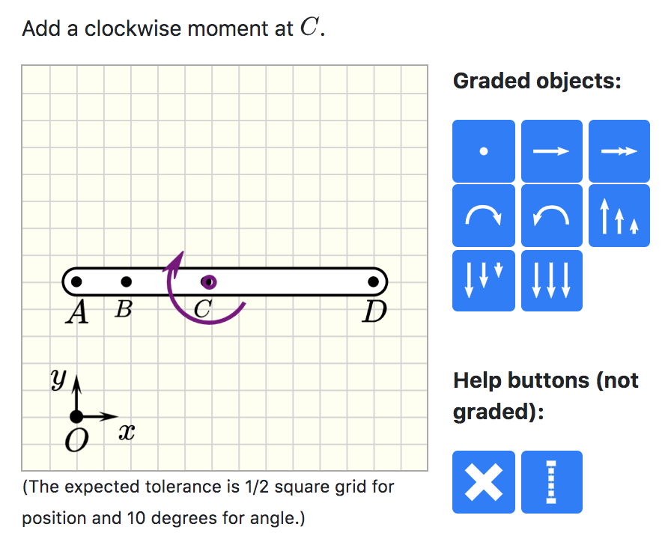
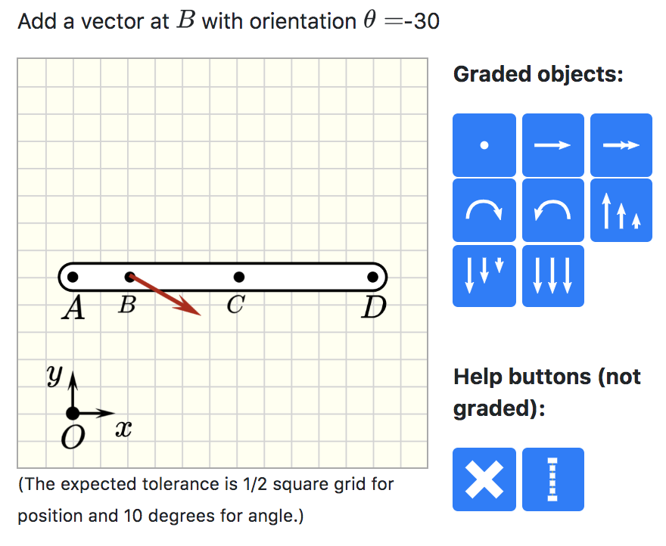

Slide 21
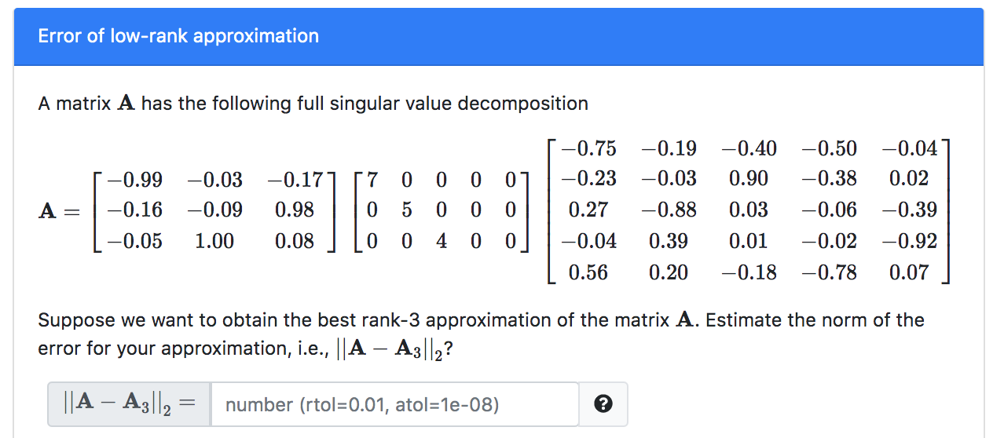
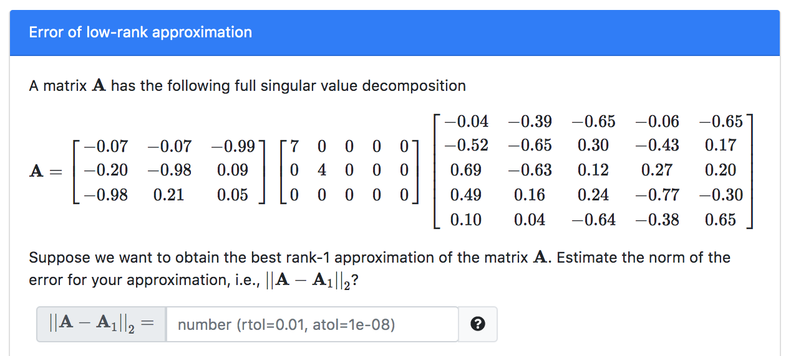

Slide 22
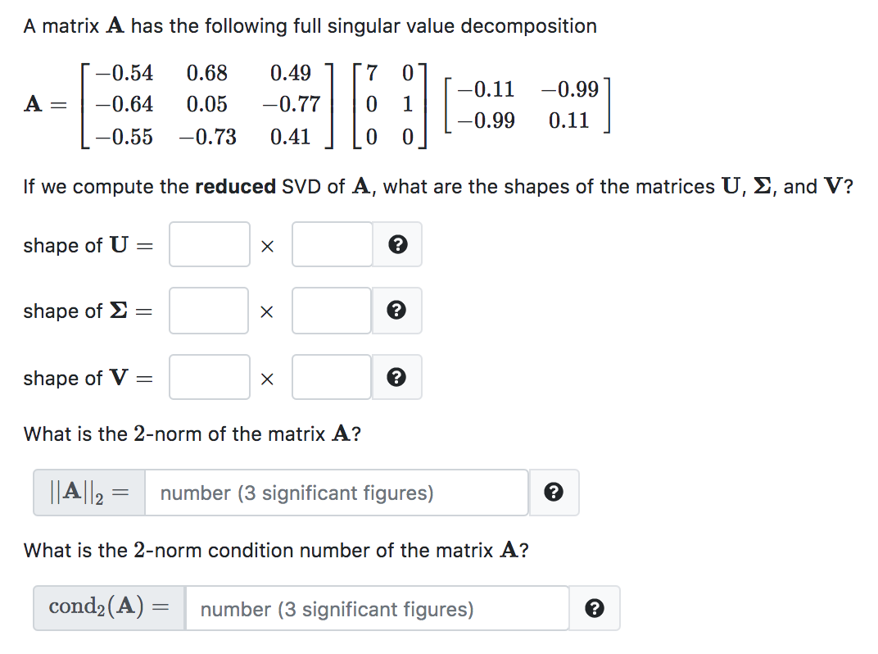
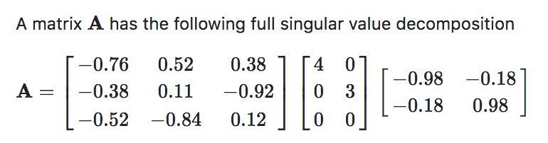
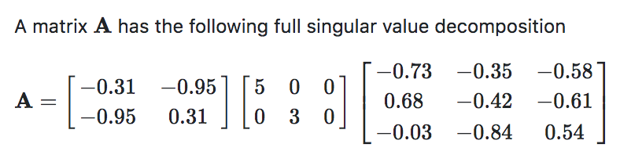
Singular values are generated such that they are always positive integers.

Slide 23
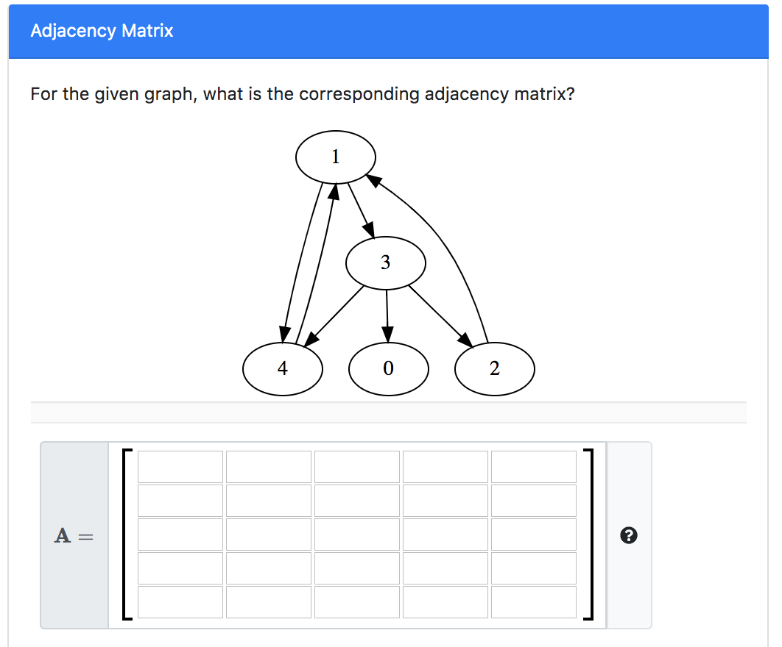
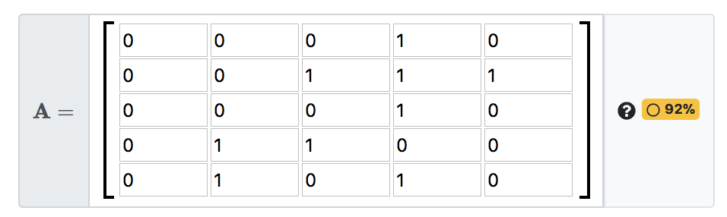
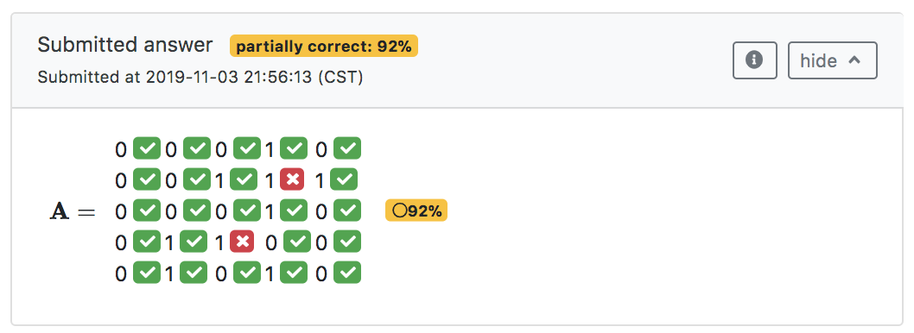

Slide 24
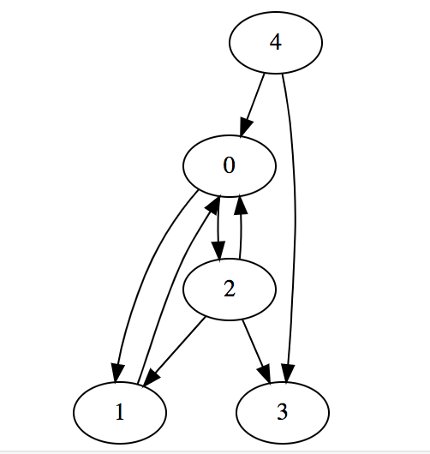
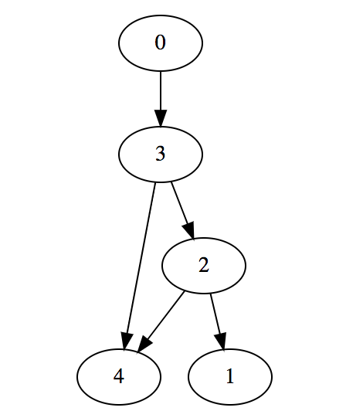
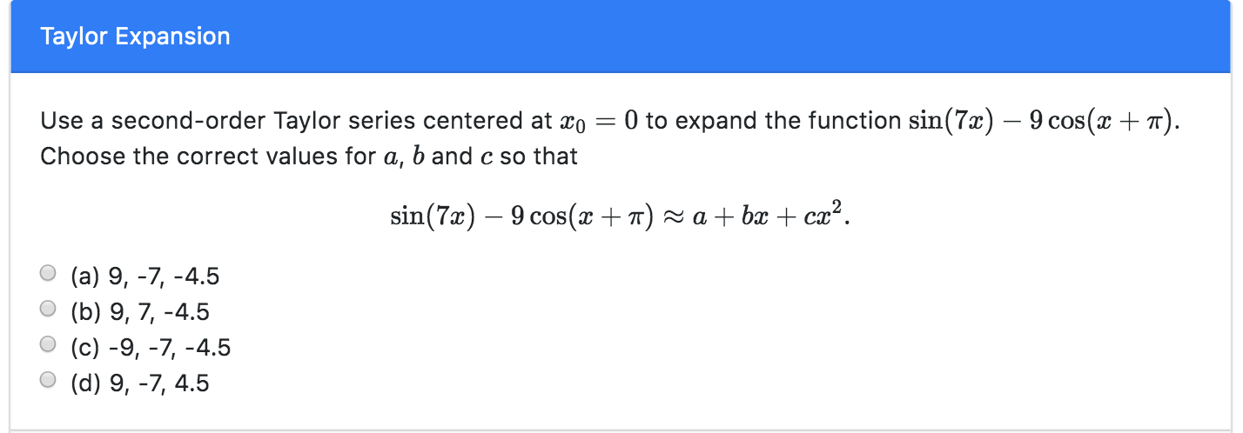

Slide 25
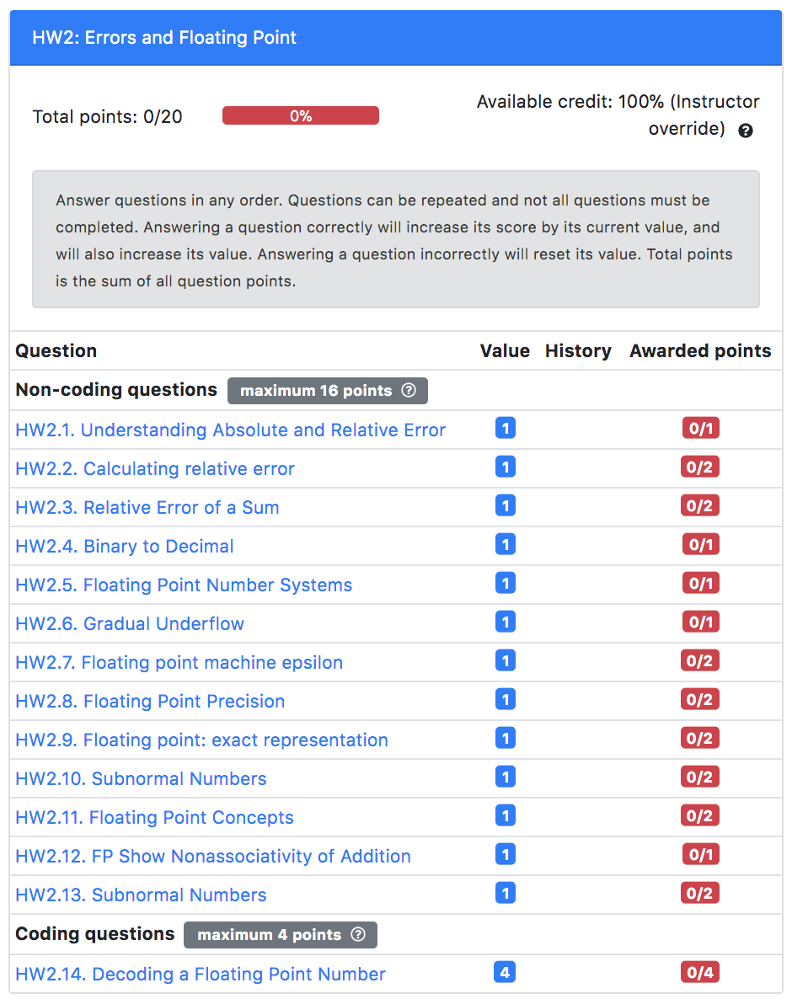
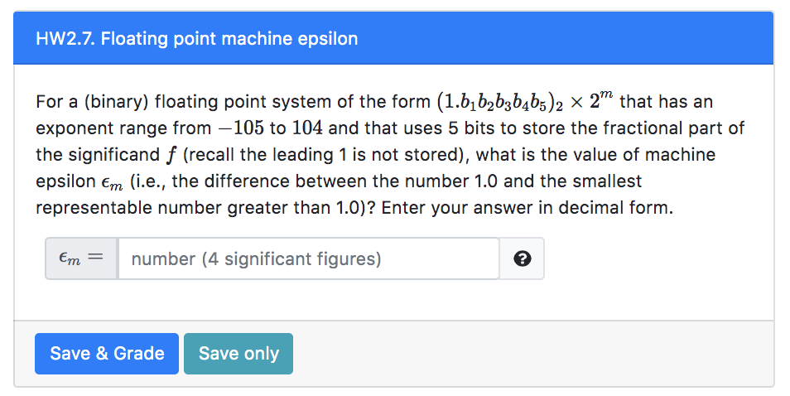
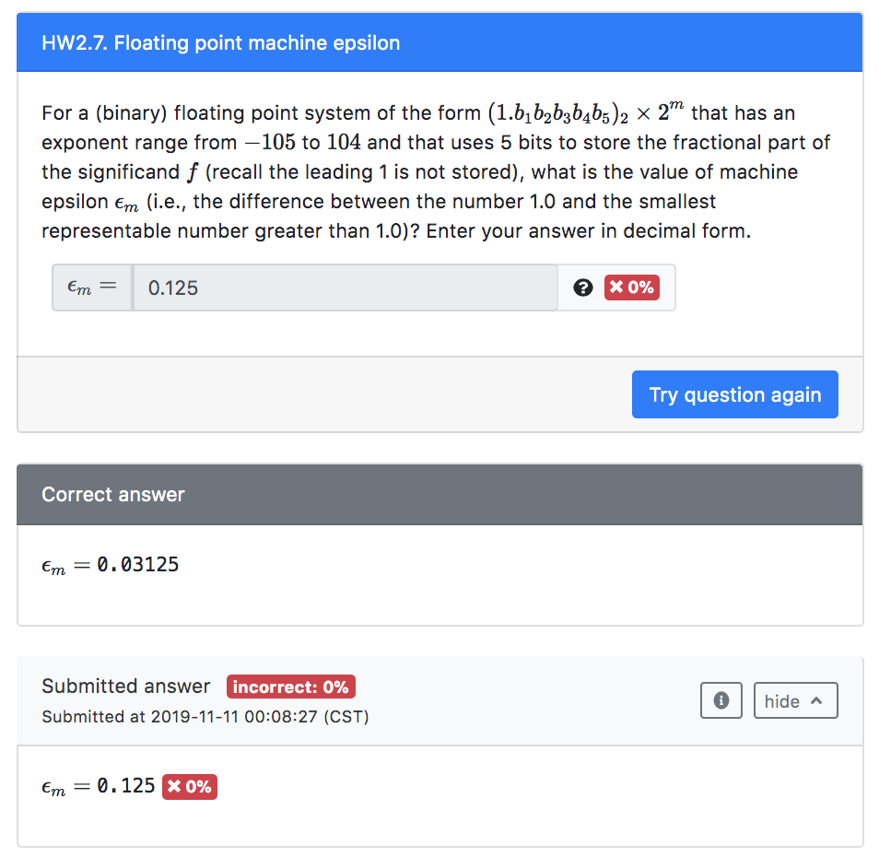
This button generates another instance of the problem

Slide 26
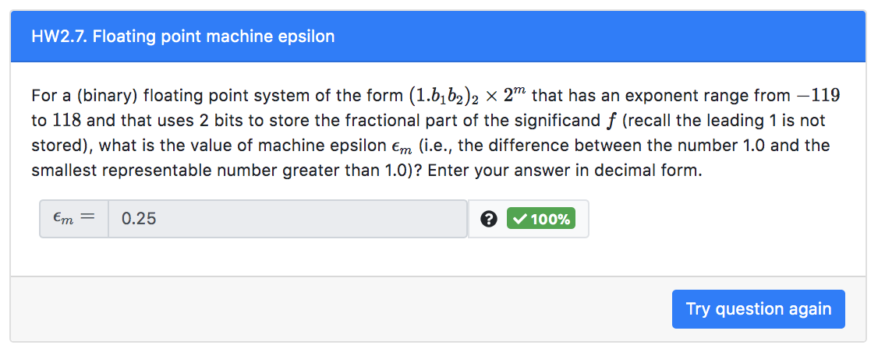

Slide 27
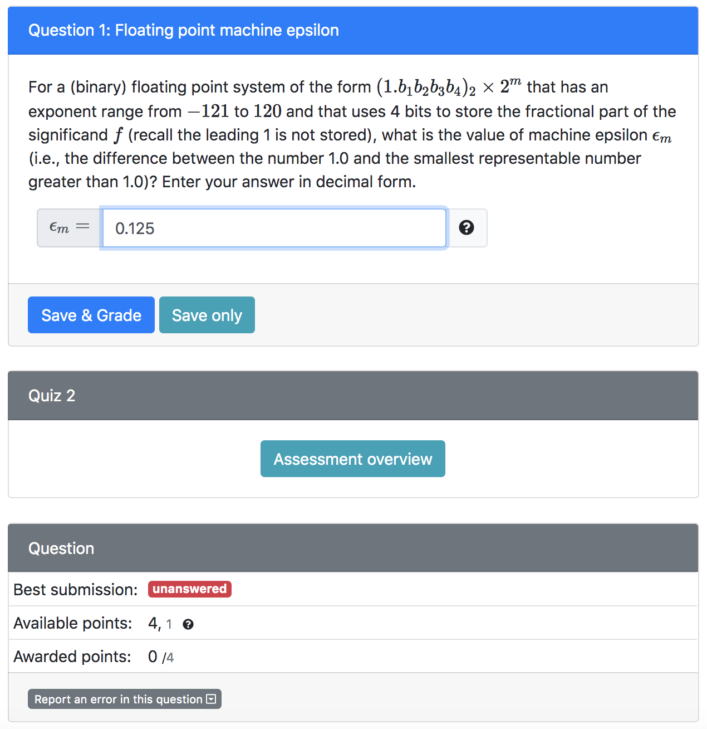
Students can save questions, and grade them all together at the end of the quiz, or they can grade questions separately
In the first attempt, students have 4 available points for this question (out of a total of 4). If they get the question marked as incorrect, the next attempt is worth 1 point.

Slide 28

Still one attempt remaining with a reduced point value (here the second attempt is worth 1 point, and is the last one for this question)
After clicking “Save & Grade”, the submitted answer is displayed, and here shown as incorrect (no awarded points)

Slide 29

Students can save questions, and grade them all together at the end of the quiz, or they can grade questions separately
This example illustrates the display when a submitted answer is saved.
This question awards a total of 4 points. In the first attempt, students get the full credit, i.e., 4 points. If they get the question marked as incorrect, they can submitted a second attempt for partial credit (here set as 1 point).

Slide 30

Still one attempt remaining for partial credit, here set as 1 point.
After clicking “Save & Grade”, the submitted answer is graded and here shown as incorrect (no awarded points)

Slide 31

The second submission is correct, and the student was awarded 1 out of the 4 total points

